Slide 1
DPTrace: Dual Purpose Trace for Exploitability Analysis of Program Crashes
Rohit Mothe (@rohitwas)
Senior Security Researcher
rohit.mothe *noSPAM* intel.com
Rodrigo Rubira Branco (@BSDaemon)
Principal Security Researcher
rodrigo.branco *noSPAM* intel.com

Slide 2
Disclaimer
We don’t speak for our employer(duh!). All the opinions and information presented here is our responsibility (actually no one has seen this talk before today)
IMPORTANT: No, we are *not* part of the Intel Security Group (McAfee)

Slide 3
Agenda
Objectives
Current state of Affairs or Security Today
Comparison with other ideas
Taint Analysis Introduction
Our approach – Dual Tracing
Demos and Analysis
Limitations
Future

Slide 4
Objectives
Contribute towards improving the state of the art in crash analysis
Automate laborious/repetitive parts, but still requiring skilled exploit writer/analyst
Discuss hybrid usage of techniques and the mixture of automation with manual analysis

Slide 5
Current State of Affairs
Buggy programs deployed on critical servers
Rapidly-evolving threats, attackers and tools (exploitation frameworks)
Lack of developers training, resources and people to fix problems and create safe code
That’s why we are here today, right?

Slide 6
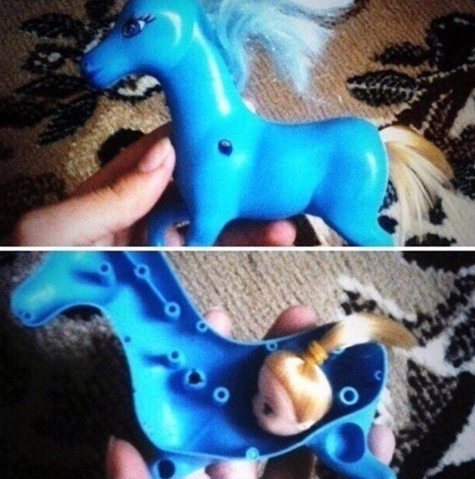
tl; dr
thnx Marcio !

Slide 7
Taint Analysis for Program Crashes
Through our work we try to answer two fundamental questions:
Are the input operands in the attacker’s control?
And if so, is the forward execution providing a primitive that is good for an attacker?
Taint Analysis is one specific kind of program flow analysis and we use it to define the influence of external data (attacker’s controlled data) over the analyzed application
Since the information flows, or is copied to, or influences other data there is a need to follow this influence in order to determine the control over specific areas (registers, memory locations). This is a requirement in order to determine exploitability

Slide 8
History and Lore- Backward-Taint
Original Motivation: Complex client-side vulnerability in a closed (at the time) file format
Extended Motivation: Trying to better analyse hundreds of thousands of bugs in Microsoft Word (search for Ben Nagy, Coseinc)
Initial version integrated with a fuzzer, only for Linux (showed in 2011 at Troopers)
Ported version for Solaris to analyze a vulnerability released by Secunia in the same software RISE Security released a vulnerability a month before (also circa 2011)
Thanks to Julio Auto’s parallel research in the same field, a Windows version was created (extended in this research)

Slide 9
History and Lore- Forward-Taint
Original Motivation: Triaging submissions in a vulnerability purchase program is hard. Many submissions lack a complete exploit but still might have real value
Extended Motivation: Categorizing fuzzing crashes is a pain (NOT bang(!) exploitable categorizing)
Manual process includes lots of repetitive steps
Automation is key. Certain classes repeat themselves (such as UAF)
‘Prototyping Exploitation’ in such cases is both cost and time effective. Also a more reasonable and simpler ‘automatable’ problem than automating exploit writing for all classes of bugs. Prototype or GTFO!

Slide 10
Existing Solutions - What we aren’t
!exploitable
Tries to classify unique issues (crashes appearing through different code paths, machines involved in testing, and in multiple test cases). Group the crashes for analysis
Quickly prioritizes issues (since crashes appear in thousands, while analysis capabilities are VERY limited)
Classic, timeless!
Spider Pig
Created by Piotr Bania
Not available for testing, but from the paper: It is much more advanced them the provided tool (but well, it is not available?)
Virtual Code Integration (or Dynamic Binary Rewriting)
Disputable Objects: Partially controlled data is analyzed using the parent data
Taint Bochs
Used for tracking sensitive data lifecycle in memory

Slide 11
Existing Solutions - What we aren’t contd..
Taint Check
Uses DynamicRIO or Valgrind
Taint Seed: Defining the tainted values (data comming from the network for example)
Taint Tracker: Tracks the propagation, Taint Assert: Alert about security violations
Used while testing software to detect overflow conditions, does nto really help in the exploit creation
Bitblaze
An amazing platform for binary analysis
Provides better classification of exploitability (Charlie Miller talk in BH)
Can be used as base platform for the provided solution (VINE)
Moflow Framework
Cisco Talos. Tools built on CMU’s BAP framework.
sliceflow- post-crash graph back taint slicer
Post-crash forward symbolic emulator looking for more exploitable conditions
Pretty neat and advanced!

Slide 12
State Transition for Memory Corruption
Case 1 (green): Format String
Case 2 and 3 (red and blue): buffer overflow
Case 4 (purple): unpredictable
Source:
Automatic Diagnosis and
Response to Memory
Corruption Vulnerabilities
c: corrupting instruction
t: takeover instruction
f: faulting instruction
Notes:
An instruction that is tricked to overwrite critical program data (return address on the stack) as a corrupting instruction
To take control of a victim process, an attack usually needs to execute a control flow transfer instruction (jmp, ret, and call) to further execute the code injected or chosen by the attack (take over instruction)
Instruction that causes a process to crash is a faulting instruction.
Case 1 example: format string attack
Case 2 example: a stack buffer overflow attack, the overrun may corrupt return address as well as other stack variables. An instruction that dereferences such a variable before the function returns may cause a crash
Case 3 example: the corrupted return address would be invalid and cause the crash when the ret instruction is executed
Case 4 example: a corrupted data may be used by an instruction, causing a crash

Slide 13
Moving Backward
Legitimate assumption:
To change the execution of a program illegitimately we need to have a value being derived from the attacker’s input (which we call: controlled by the attacker)
String sizes and format strings should usually be supplied by the code itself, not from external, un-trusted inputs
Any data originated from or arithmetically derived from un-trusted source must be inspected

Slide 14
Analyzing Taint
Tainted data: Data from un-trusted source
Keeps track of tainted data (from un-trusted source)
Monitors program execution to track how tainted attribute propagates
Detect when tainted data is used in sensitive way

Slide 15
Taint Propagation
When a tainted location is used in such a way that a value of other data is derived from the tainted data (like in mathematical operations, move instructions and others) we mark the other location as tainted as well
The transitive relation is:
If information A is used to derive information B:
A->t(B) -> Direct flow
If B is used to derive information C:
B->t(C) -> Direct flow
Thus: A->t(C) -> Indirect flow
Due to the transitive nature, you can analyze individual transitions or the whole block (A->t(C))

Slide 16
Location
A location is defined as:
Memory address and size
Register name (we use the register entirely, not partially -> thus %al and %eax are the same)
When setting a register, we set it higher (setting %al as tainted will also taint %eax)
When clearing a register, we clear it lower
To keep track over bit operations in a register it is important to taint the code-block level of a control flow graph
This create extra complexity due to the existence of the flow graph and data flow dependencies graph
The dependencies graph represents the influence of a source data in the operation been performed

Slide 17
Flows
Explicit flow:
mov %eax, A
Implicit flow:
If (x == 1) y=0;
Conditional statements require a special analysis approach:
In our case, we are analyzing the trace of a program (not the program itself, but only what was executed during the debugging section)
We have two different analysis step: tracing and analysis

Slide 18
Special Considerations
Partial Tainting: When the untrusted source does not completely control the tainted data
Tainting Merge: When there are two different untrusted sources being used to derive some data
Data
In Use: when it is referenced by an operation
Defined: when the data is modified

Slide 19
Inheritance problems
Problem: state explosion for binary operations !
Application
Propagation Tracking
Inheritance Tracking
mov %eax ← A
mov B ← %eax
taint(%eax) = taint(A)
taint(B) = taint(%eax)
%eax inherits from A
B inherits from %eax
add %ebx ← D
taint(%ebx) |= taint(D)
insert D into %ebx’s inherit-from list
Events
Rare e.g., malloc/free, system calls
Frequent e.g., memory access, data movement

Slide 20
Tracking Instructions
Pure assignments: Easy to track
If a tainted location is used to define another location, this new location will be tainted
Operations over strings are tainted when:
They are used to calculate string sizes using a tained location
a = strlen(tainted(string));
Since the ‘string’ is tainted, we assume the attacker controls ‘a’
Search for some specific char using a tainted location, defining a flag if found or not found
pointer = strchr(tainted(string), some_char);
If (pointer) flag=1;
‘flag’ is tainted if the attacker controls ‘string’ or ‘some_char’

Slide 21
Tracking Instructions contd..
Arithmetic instructions with at least one tainted data usually define tainted results
Those arithmetic instructions can be simplified to map to boolean operations and then the following rules applies

Slide 22
Eflags and Flow Information
The eflags register can also be tainted to monitor flags conditions influencing in operations (and flow)
In the presented approach, conditional branches are taken care due to the trace generated by the WinDBG plugin (single-stepping)

Slide 23
Backward Taint Analysis
Divide the analysis process in two parts:
A trace from a good state to the crash (incrementally dumped to a file) -> Gather substantial information about the target application when it receives the input data, which is formally named 'analysis'
Analysis of the trace file -> Formally defined as 'verification' step, where the conclusive analysis is done
Notes:
Add here information on the forward process and the fact that now we can do from the WinDBG console

Slide 24
Forward Taint Analysis
To see what kind of primitives (read/write/calls) are available we ‘prototype’ input control and allocate a fake object structure in memory such that the program can continue from the point of the crash to other code paths.
The property of such fake memory structure should guarantee to a reasonable extent that any memory references (like virtual function tables or other object pointers) will be resolved including memory address references that are additive or subtractive to the faulting address(which is already assumed controllable).
In essence one could imagine it as simulating the reallocation of a fake object ‘within’ the debugger in a use-after-free situation and continuing the exception. Or allocating an adjacent object in an out of bounds access violation, etc.

Slide 25
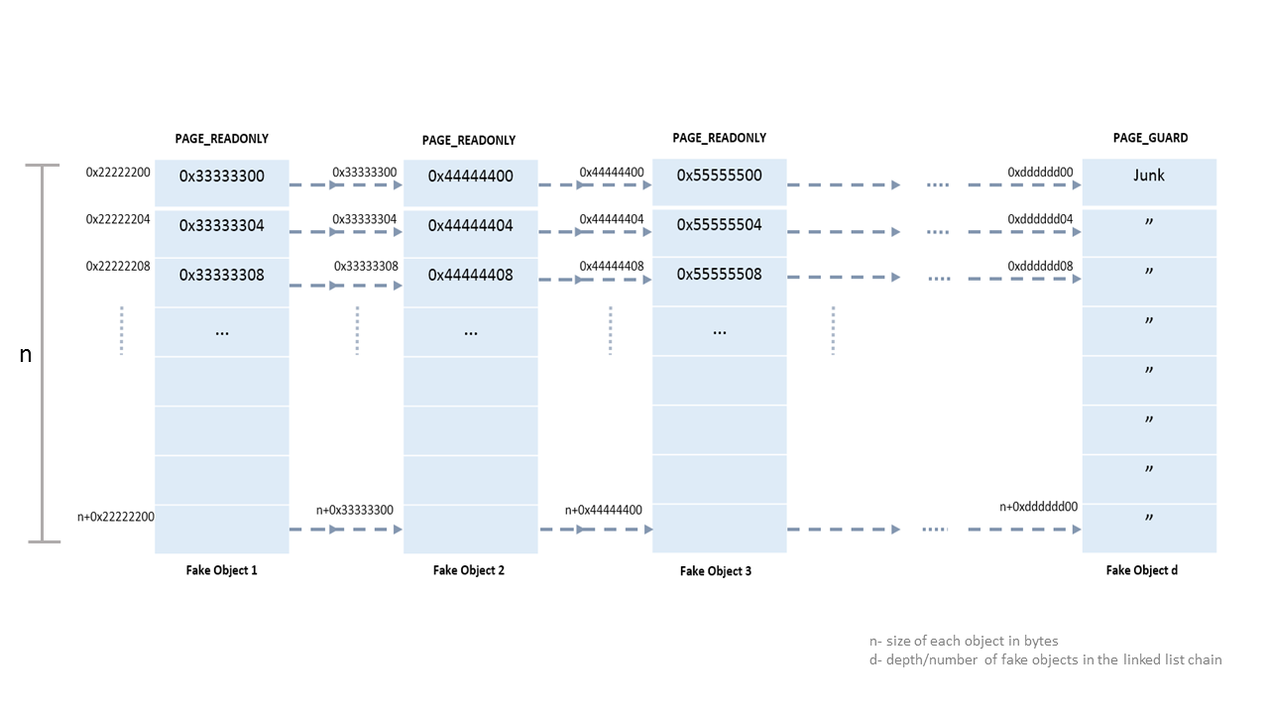
Fake Memory Structure Sample

Slide 26
Forward Logic
In the debugger you see a seemingly non exploitable read AV (access violation).
Example: mov eax ,[ecx] ; ( ecx is supposed here to be a pointer to attacker controlled memory.)
You allocate a chunk of memory within the process (preferably the size of the memory pointed to by ecx to mimic an accurate freed block control using heap massaging,feng-shui)
The permissions of all memory blocks in a linked list chain are read-only. So any attempt to write/execute on any of the values within the memory blocks would cause an exception later and that shows evidence of exploitability
Now manually change the ecx value in the crash to point to the address of the root of this linked list which is the root of the chain of memory blocks pointing to one another
Continue the program execution and it will continue from the point of crash with the modified value of ecx.

Slide 27
Need for Intermediate Languages
Assembly instructions have explicit operands, which are easy to deal with, and sometimes implicit operands:
Instruction: push eax
Explicit operand: eax
What it really does?
ESP = ESP – 4 (a substraction)
SS:[ESP] = EAX (a move)
Here we have ESP and SS as implicit operands
Tks to Edgar Barbose for this great example!

Slide 28
Implementing the Tracer
Instead of using an intermediate language, we play straight with the debugger interfaces (WinDBG). Windbg or GTFO!
The tracer stores some useful information, like effective addresses and data values and also simplifies the instructions for easy parsing:
CMPXCHG r/m32, r32 -> 'Compare EAX with r/m32. If equal, ZF is set and r32 is loaded into r/m32. Else, clear ZF and load r/m32 into AL'
Such an instruction creates the need for conditional taints, since by controlling %eax and r32 the attacker controls r/m32 too.

Slide 29
Implementation Details
Instead of using an intermediate language, we play straight with the debugger interfaces (WinDBG). Windbg or GTFO!
Trace File Contains:
Mnemonic of the instruction and operands
Dependences for the source operand
Eg: Elements of an indirectly addressed memory
This creates a tree of the dataflow, with a root in the crash instruction
The verification (GUI and cmdline program) step reads this file and:
Search this tree using a BFS algorithm
Forward step uses the debugger interfaces for the memory allocation and forward execution

Slide 30



ICE CREAM ICE CREAM ICE CREAM ICE CREAM ICE CREAM ICE CREAM ICE CREAM ICE CREAM ICE CREAM ICE CREAM ICE CREAM ICE CREAM ICE CREAM ICE CREAM ICE CREAM ICE CREAM ICE CREAM ICE CREAM ICE CREAM ICE CREAM ICE CREAM

Slide 31

Program Execution Timeline
Program start
Trace! Check Taint! Forward Execution
Initial Crash, AV
Trace! Check Taint! Forward Execution
Exception → Constraint 1
…
…
…
…
…
…
Trace! Check Taint! Forward Execution
Exception → Constraint n
…
…
Trace! Check Taint!
Exploitable Primitive?! Profit!
…
…
OR march on, down to hell ☹

Slide 32
Theoretical Example
1-) mov edi, 0x1234 ; dst=edi, src=0x1234
2-) mov eax, [0xABCD] ; dst=eax, src=ptr 0xABCD ; Note 0xABCD is evil addr
3-) lea ebx, [eax+ecx*8] ; dst=ebx, src=eax, srcdep1=ecx
4-) mov [edi], ebx ; dst=ptr 0x1234, src=ebx
5-) mov esi, [edi] ; dst=esi, src=ptr 0x1234, srcdep1=edi
6-) mov edx, [esi] ; Crash!!!

Slide 33
Theoretical Example contd..
6-) Where does [esi] come from?
5-) [edi] is moved to esi, where edi comes from and what does exist in [edi]?
4-) [edi] receives ebx and edi is defined in 1-) from a fixed value
3-) ebx comes from a lea instruction that uses eax and ecx
2-) eax receives a value controlled by the attacker
... ecx is out of the scope here :)

Slide 34
Assumptions & Challenges
Since we only use the trace information, if the crash input data does not force a flow, we can’t see the influence of the input over this specific flow data
To solve that:
If a jmp is dependent of a flag, the attacker controls branch decision
Control over a branch means tainted EIP
To define the value of EIP, consider:
The address if the jump is taken
The address of the next instruction (if the jump is not taken)
The value of the interesting flag register (0 or 1)
Then: %eip <- (address of the next instruction) + value of the register flag * ( |address if jump is taken – address of the next instruction| )

Slide 35
Forward Analysis
The method here was conceived originally to help determine whether crashes for potential UAF (Use-After-Free) bugs in browsers are exploitable or not
UAFs in browsers or any significantly large programs for that matter are often hard to analyze for exploitability and typically involve following varied code paths in the control flow to find a write access violation/potential code redirection using indirect calls
The idea is not just limited to UAFs though
After input control(first part of the problem) has been determined, the next logical step is to gauge what can be done with it.

Slide 36
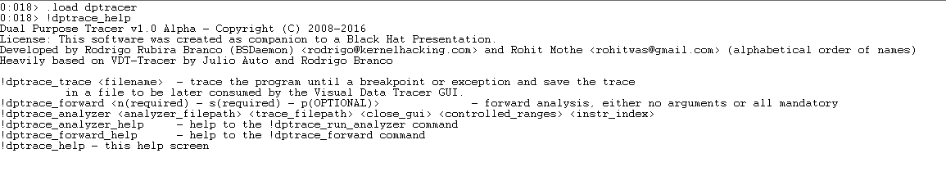
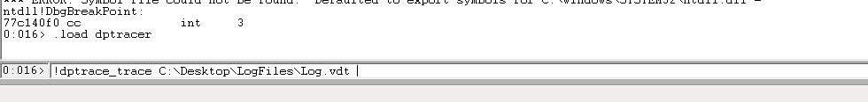
Command-line options

Slide 37
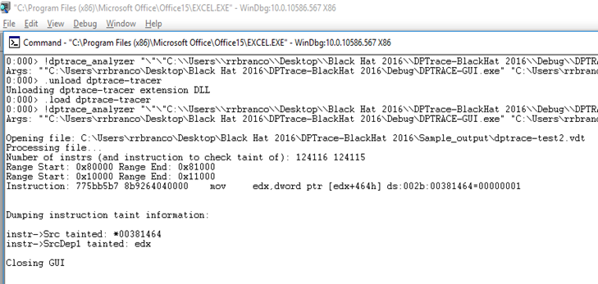
Analyzer

Slide 38
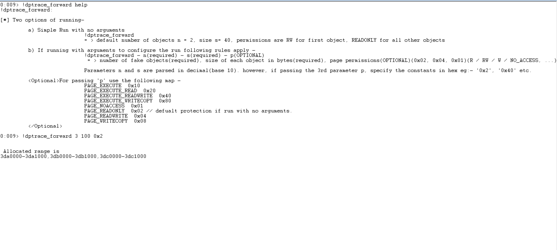
Forward

Slide 39
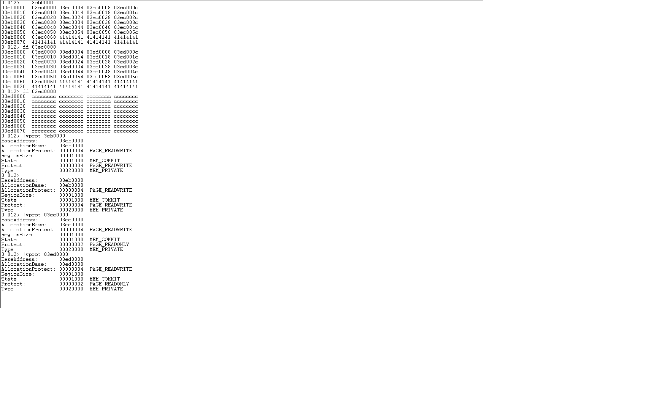
Forward

Slide 40

Sample Analysis on dead bugs

Slide 41
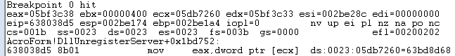
Sample Analysis 1
We did a bit of cheating to avoid huge traces (from that point on
til the crash, we would have traced more than 10 million instructions)
- CVE-2010-0188 – Adobe Reader Libtiff TIFFFetchShortPair Stack-based Buffer Overflow
- TIFF file embedded in a PDF were the IFD Entry has Tag ID (0x0129, 0x0141, 0x0212 or 0x0150) and Tag Type 3 (short)
- The field data count of the TIFF file will be used as size (dc*2) to copy to a fixed buffer in stack

Slide 42
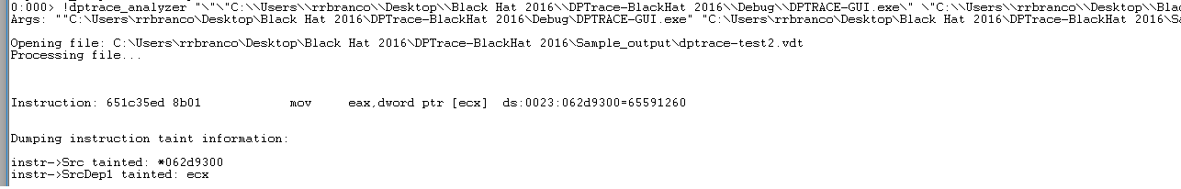
Contd…
At the crash point, we check the trace to see if the pointer is
Indeed controlled
Notes:
The offending instruction is checked in the command line

Slide 43
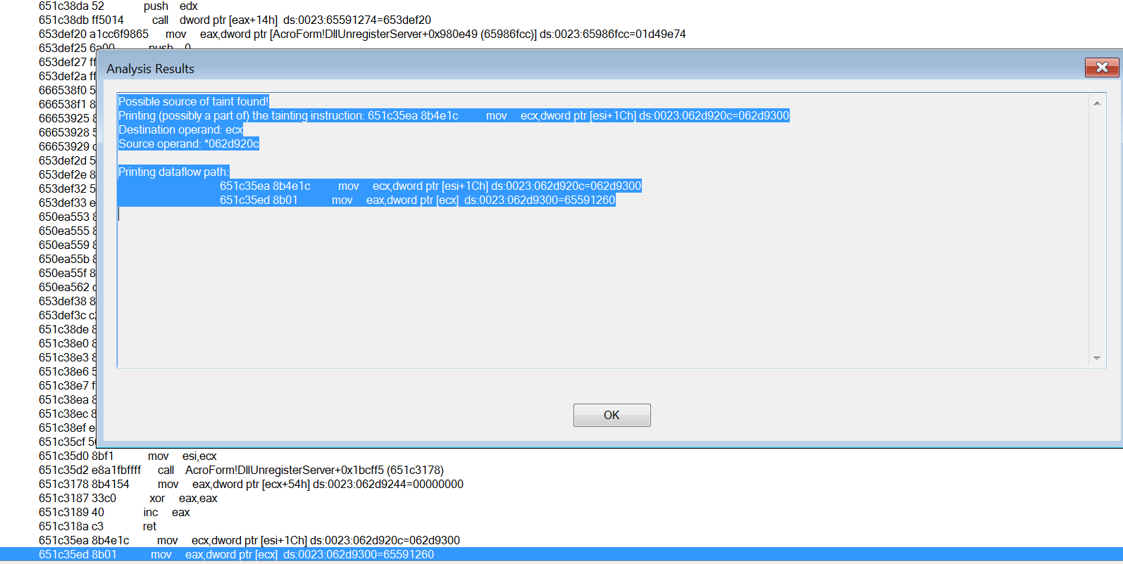
Contd…
Dataflow information can be visualized in the GUI

Slide 44
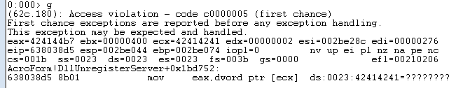
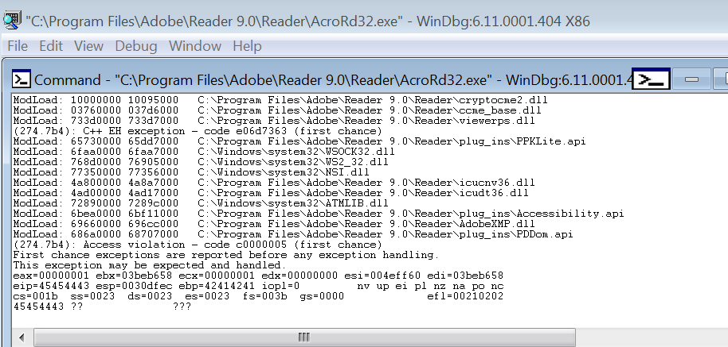
Contd…
We indeed control the values (coming from our input file)

Slide 45
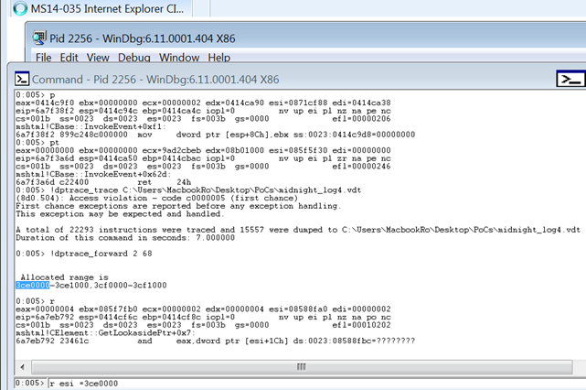
Sample Analysis 2
CVE-2014-0282 IE8/9/10/11 ‘Cinput’ Use-After-Free (MS14-035)

Slide 46
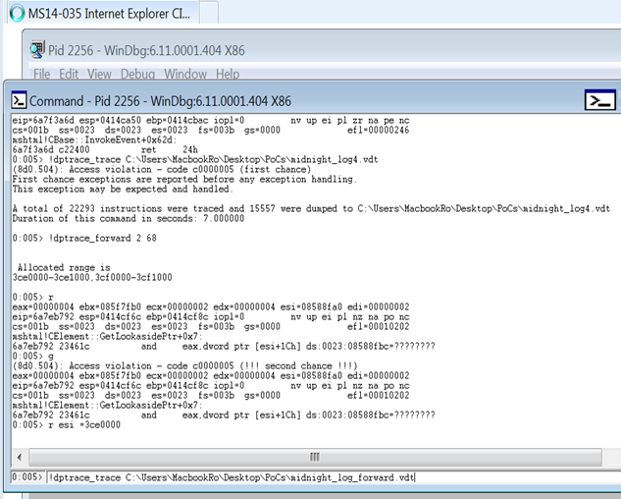
Contd…
Replace Freed object with the root of the fake object chain

Slide 47
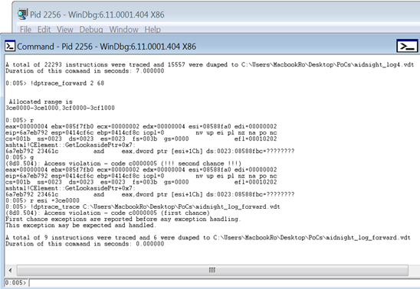
Contd…
Continue from initial crash and trace each subsequent breakpoint/access violation

Slide 48
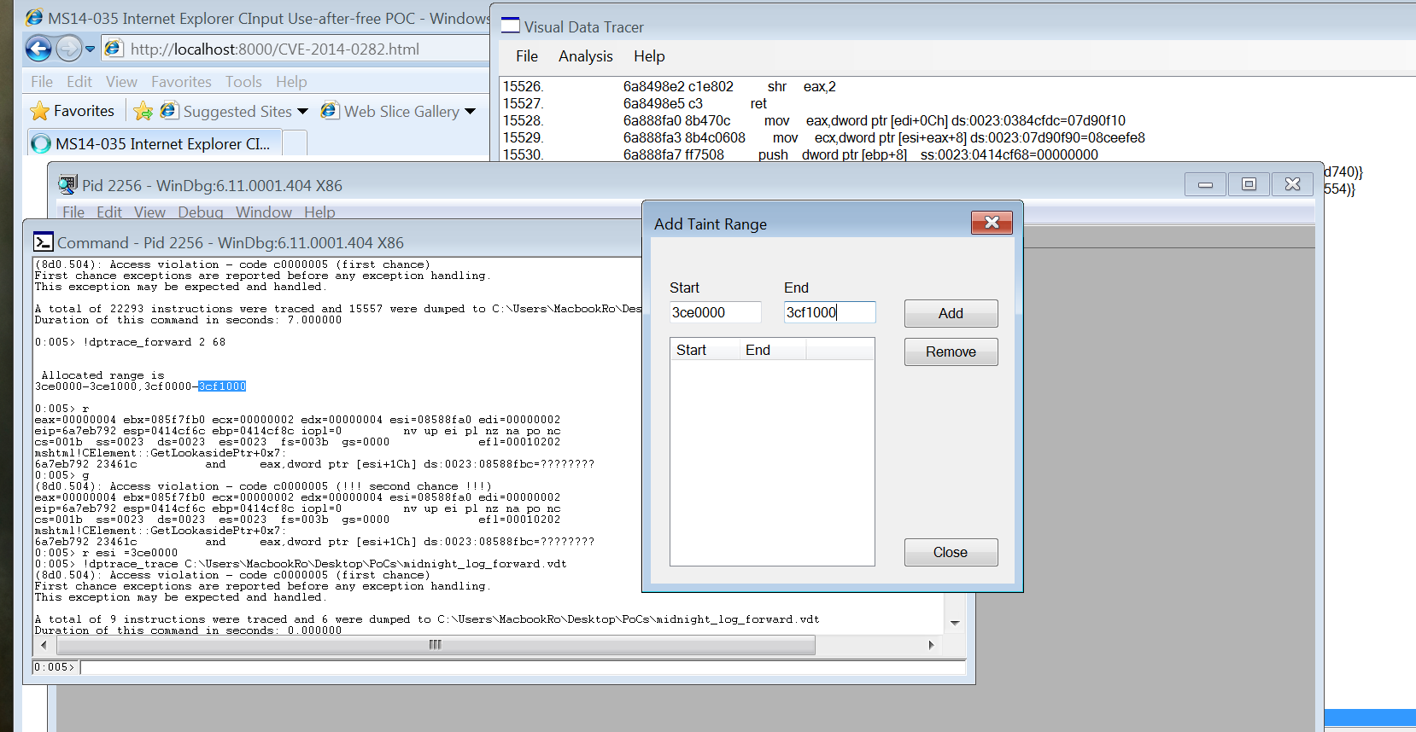
Contd…
Add the range of the fake allocated objects, so when we look for the taint information on the instruction of interest, we can confirm it is mapped to our controlled memory areas

Slide 49
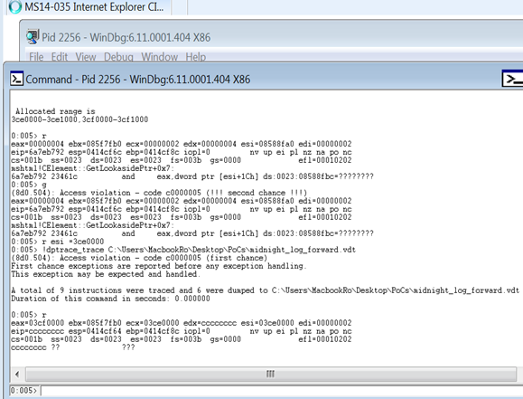
Contd…
Program Control Immediately evident. We just need to make sure we can point indeed it to our fake structure

Slide 50
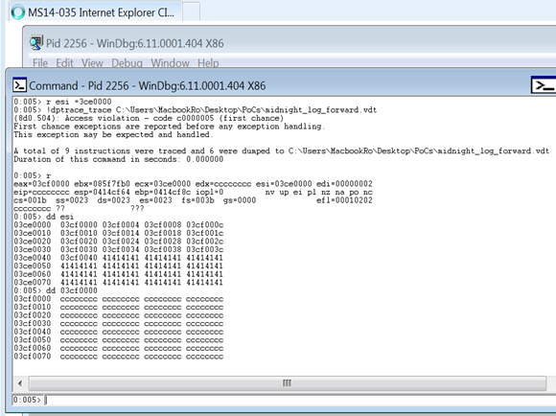
Contd…
We see that the EIP value at time of crash comes from our fake object allocated at the previous crash

Slide 51
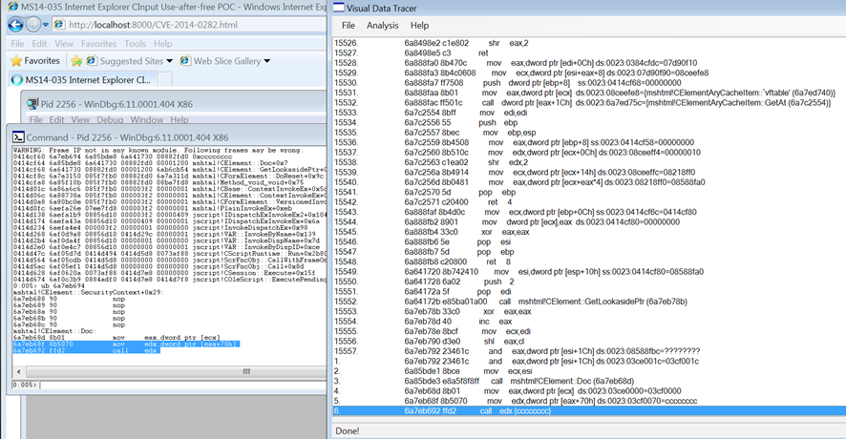
Contd…
Visualize it in the tracer and trace the program control (or directly in the command line of the debugger, shown later)

Slide 52
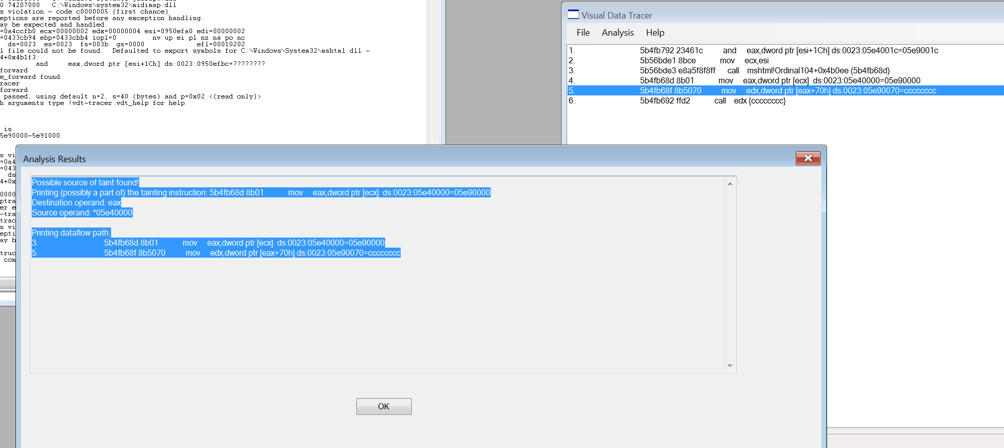
Contd…
Taint source is confirmed also in the analyzer (visual here). Same thing can be obtained in the command line by !dptrace_analyzer <analyzer_binary> <trace_file> <keep GUI open> <ranges> <index of instruction to check the taint of>

Slide 53
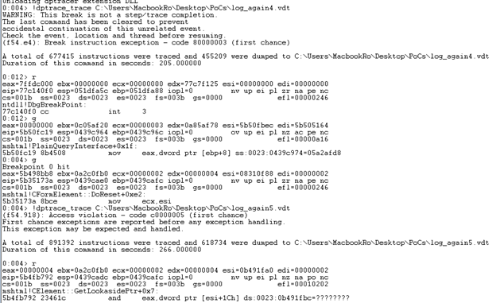
Contd…
Because the backward taint analysis demand tracing the process, so we can later construct the BFS analysis, it is important to use intelligently/diligently. In the case of this issue, we use to analyze a part of the execution, instead of the initial crash.

Slide 54
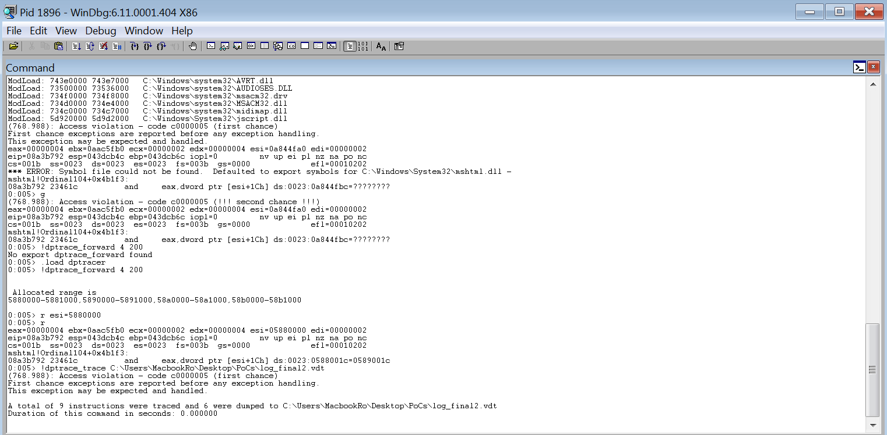
Contd…

Slide 55
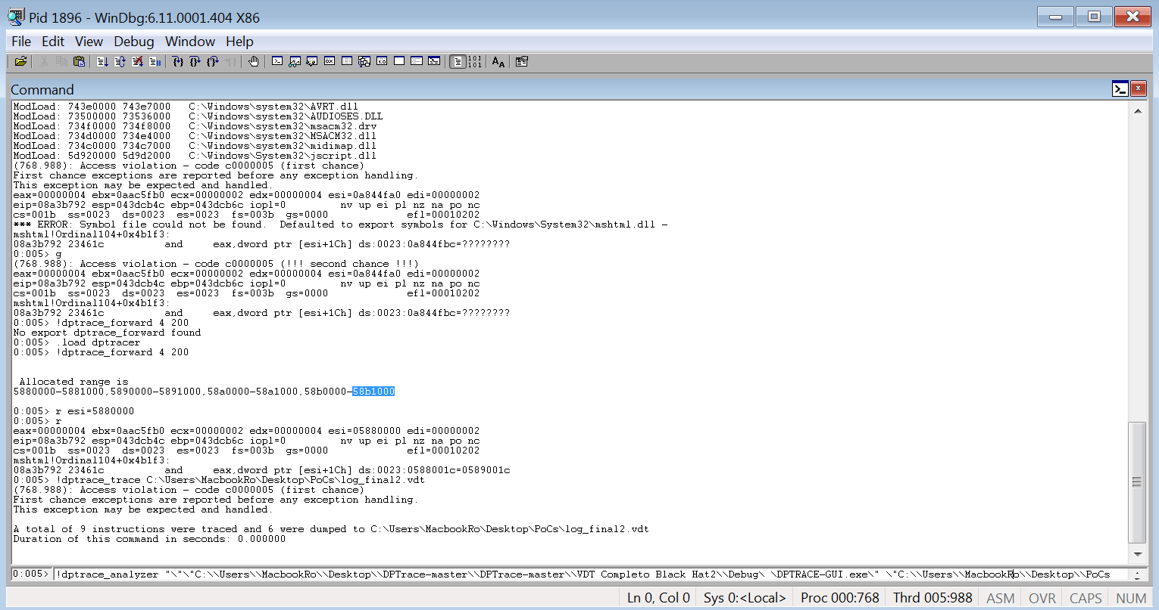
Contd…

Slide 56
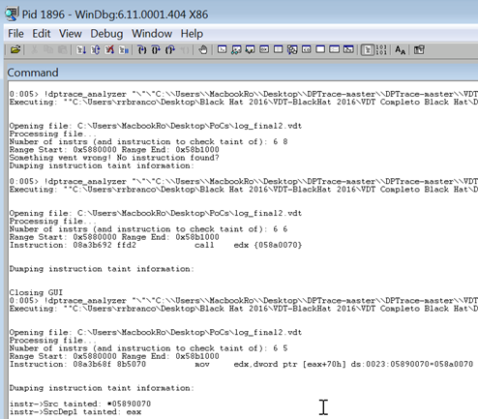
Contd…
Everything that was done using the GUI (setting the taint ranges, defining the instruction of interest and analyzing its taint information) is possible to do via the command-line of the debugger, as shown here

Slide 57
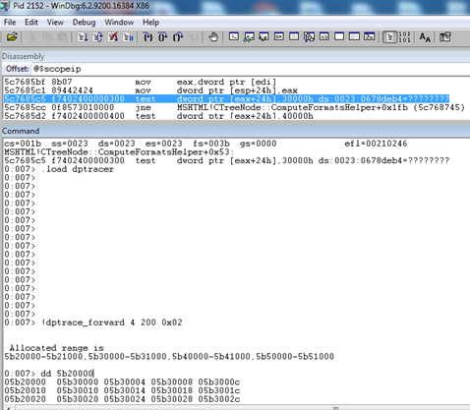
Sample Analysis 3
CVE-2015-6152 IE 11 CObjectElement Use-After-Free . Initial Crash on IE 11 without patches.

Slide 58
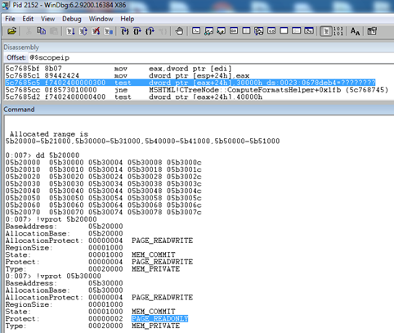
Contd…
Fake object chain of 4 objects of size 200. Precise size can be determined by manual analysis to figure out the freed/alloc’d function and checking the size of the root object.

Slide 59
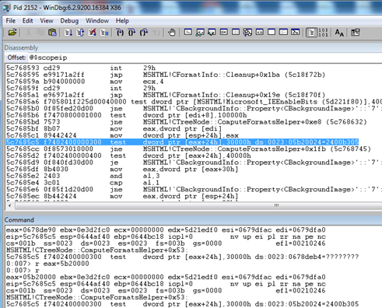
Contd…
‘Redefine’ the reference to freed reference (eax) with the first fake object . Continue the execution with !dptrace_trace and monitor the forward trace .

Slide 60
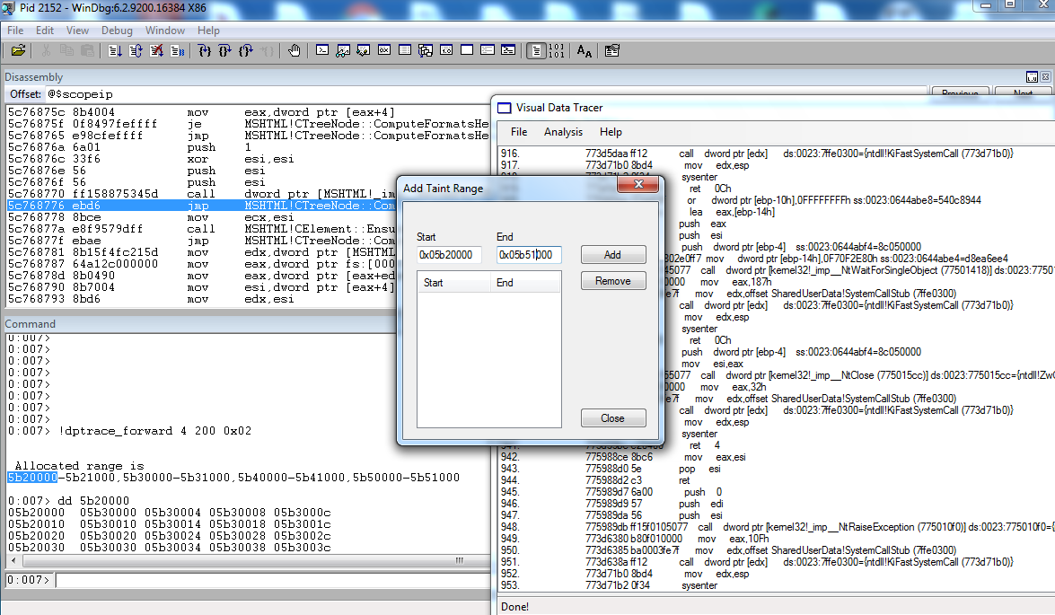
Contd…
Add taint range and check to see if the source of an access violation can be traced back to controlled input

Slide 61
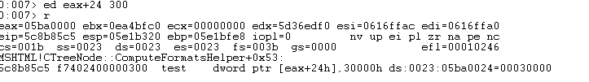
Contd…
Following another path by meeting a new constraint

Slide 62
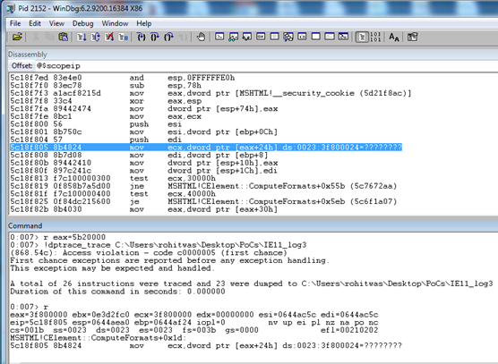
Contd…
More constraints

Slide 63
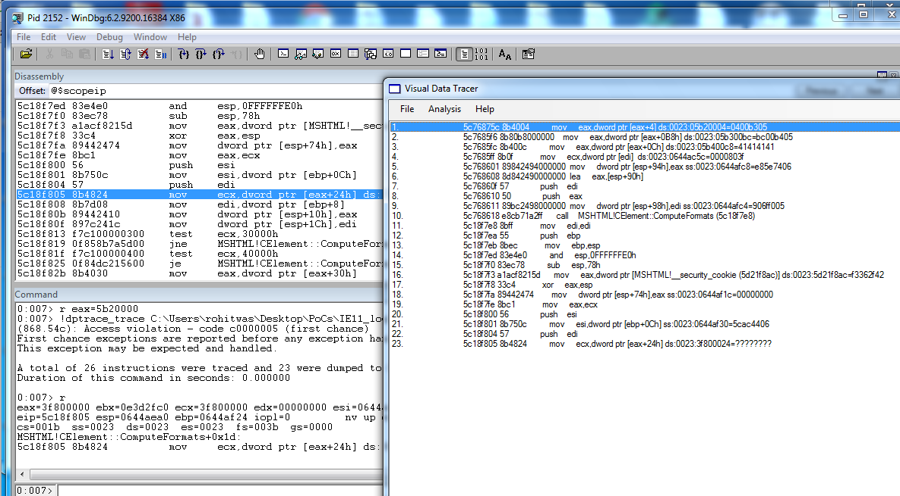
Contd…
Checking the taint source again. This particular execution run leads us to uncertainty and we aren’t sure of an exploitable primitive yet.

Slide 64
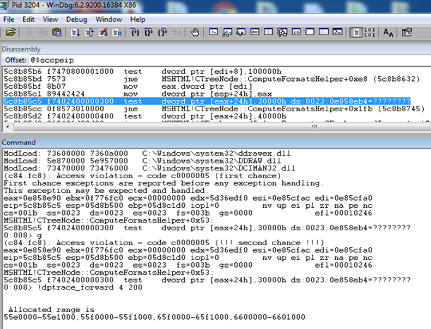
Contd…
So we carry on another execution while trying to meet some other constraints and hit an alternate code path this time.

Slide 65
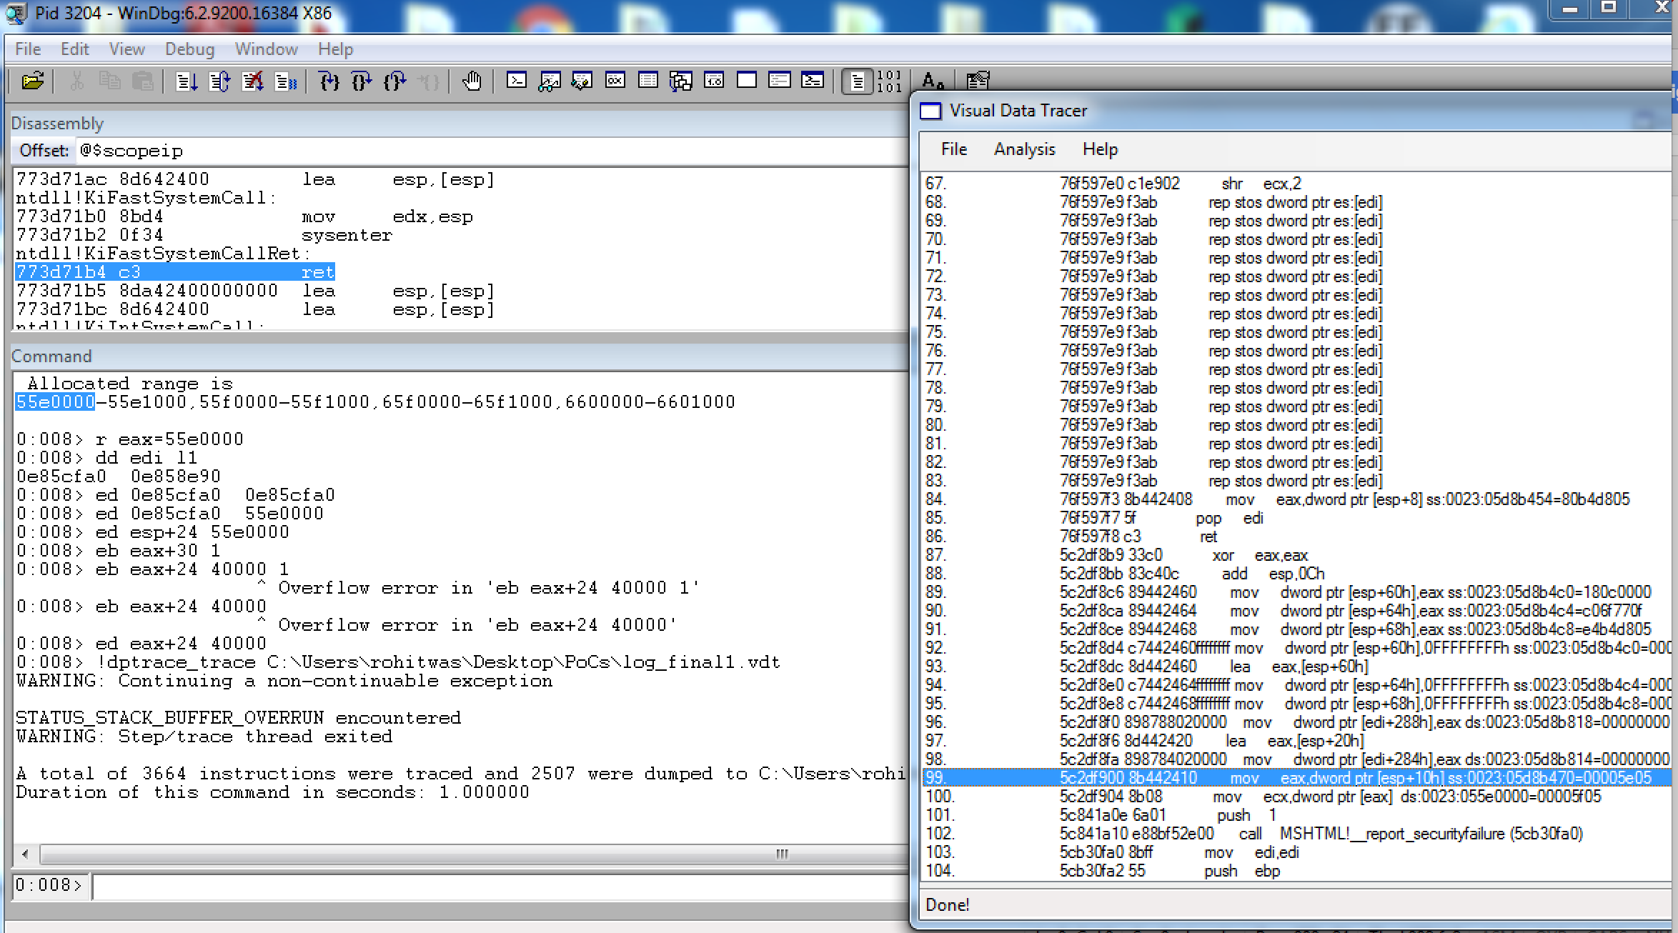
Contd…
We try another path this time by crafting some different values within the fake object, notably the value of 0x40000 in the dword @ fake_object+0x24. We also modify references to the same fake object in edi (CTreeNode *) and on the stack (esp+24). Hit a more interesting exception!

Slide 66
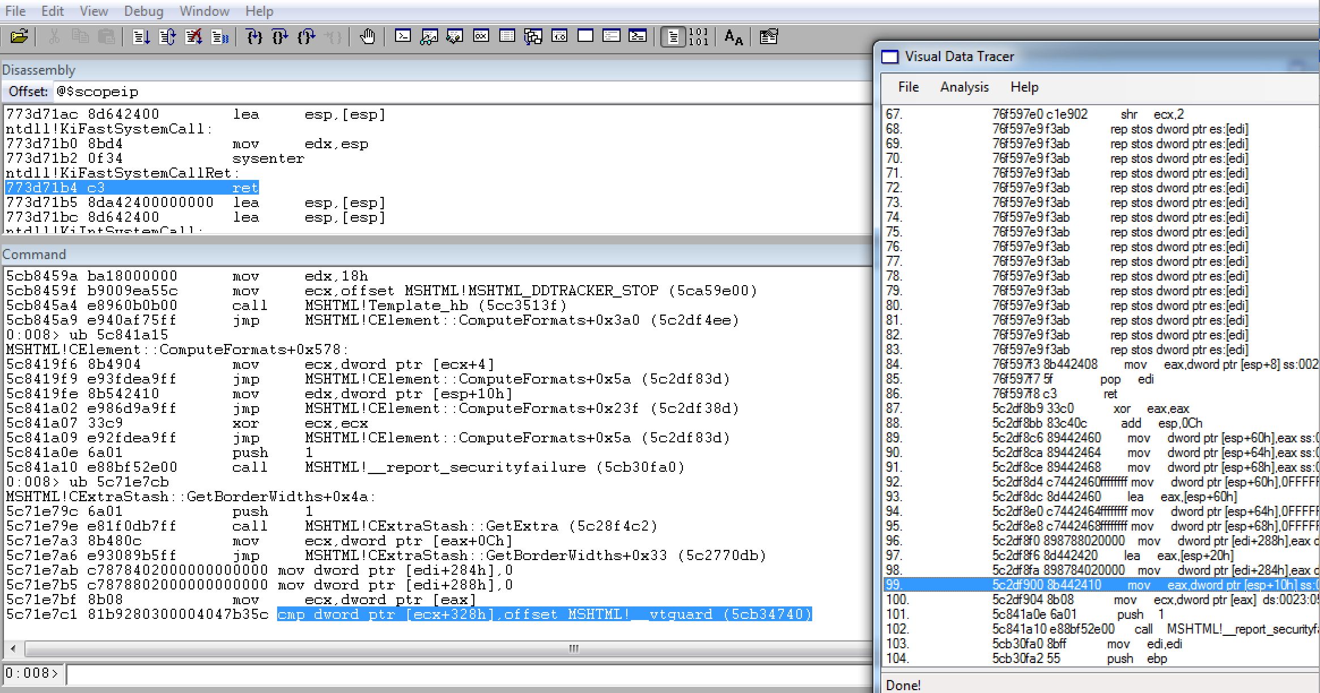
Contd…
Preliminary analysis shows us that the MSHTML!!report_securityfailure call was triggered due to a failed VTguard_check (next figure)

Slide 67
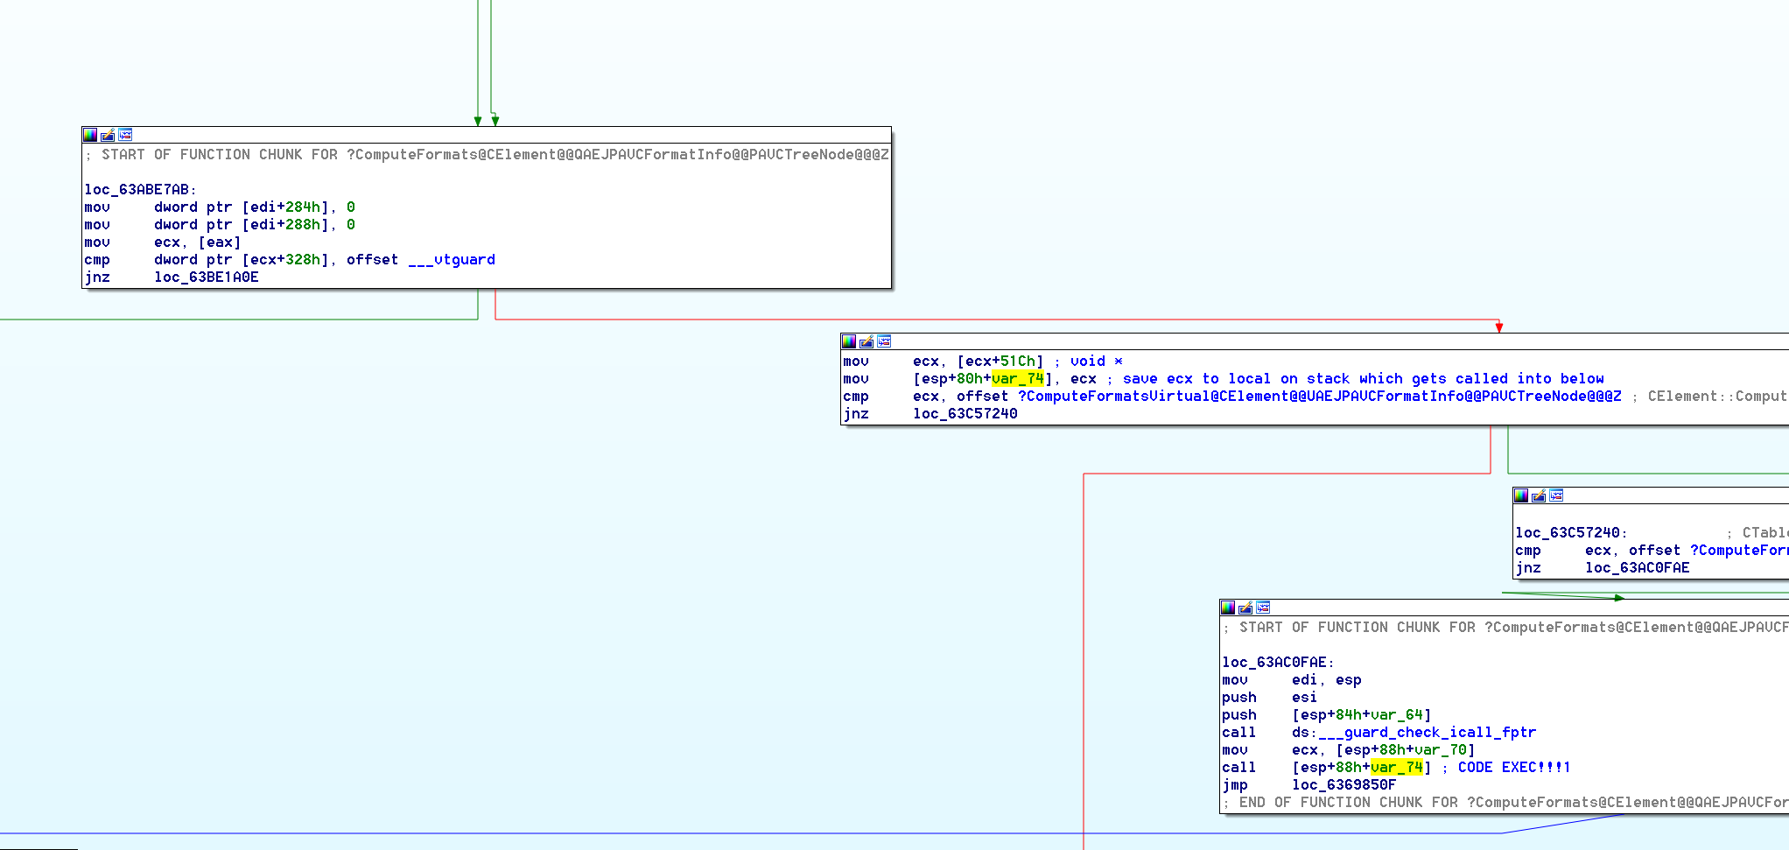
Contd…
Confirm taint control and we influence the pointer which is dereferenced to do the vtguard check. That there is code execution right after the vtguard_check can either be looked into the debugger or within IDA for more clarity as shown above

Slide 68
Challenges & Limitations
Determining the actual range of memory which needs to be traced. Determining this is easier for some cases (like file format bugs) whereas for browser based bugs this can be difficult (and sometimes unnecessary)
Explosion and partial tainting (we assume full control when merging taint)
Because the tracer outputs instruction information, it needs to understand the semantics of it (for example, source and destination operands):
It only supports the most basic x86 subset (no x87, MMX, XMM, etc) (future versions , also, helping is caring!)

Slide 69
Challenges & Limitations
Another limitation of the approach is covering conditional code paths that hit only on certain values expected to be in the memory address (checking of reference counters, object type tag or some other metadata that affects the control flow of the program after the crash point)
Branch Explosion! Similar problems can arise with symbolic execution approach
Manual analysis involves knowing where to break , where to start tracing, etc. The closer to the exception the better because of smaller traces and faster processing time by the analyzer
Not a magic solution that works on its own without a skilled analyst. Not a one size fits all solution either. Meant to augment crash analysis.

Slide 70
Future
We aren’t soothsayers. More like sooth-slayers \,,/
Please, read TODO.txt in the code trunk and send pull requests :p
Latest version of this presentation, paper, code and demos available at:
https://github.com/rrbranco/blackhat2016

Slide 71
Acknowledgments
Julio Auto for his previous work alongside one of the authors of this work (Rodrigo Branco) in implementing VDT (Vulnerability Data tracer) which was the original implementation of the backward taint tracing plugin
David D. Rude(@bannedit) and Kiran Bandla(@kb) for ideas and feedback regarding the initial prototype of the forward trace
All of the other researchers who contributed to this field!

Slide 72
Thanks!
Rohit Mothe (@rohitwas)
Senior Security Researcher
rohit.mothe *noSPAM* intel.com
Rodrigo Rubira Branco (@BSDaemon)
Principal Security Researcher
rodrigo.branco *noSPAM* intel.com

